Slide 1
ONLINE ART GALLARY
Aparna c
MCA
KITM24MCA-2002

Slide 2
CONTENTS
Project Introduction
Obectives
Existing System
Proposed System
ER Diagram
DFD
Table

Slide 3
INTRODUCTON
This project is about building an Online Art Gallery Website that helps artists show their work to a wider audience. Instead of displaying art in physical galleries, artists can upload their paintings or digital art on this website. People who love art can easily browse, view, and even buy artworks online.
The platform helps artists manage their collections, and it gives users a smooth browsing and buying experience. It includes features like signing up, uploading artworks, placing orders, and admin control to keep everything running smoothly. The main goal is to make it easier for artists to get noticed and for people to discover and enjoy new art—anytime, anywhere.

Slide 4
OBJECTIVES
→ To provide a user-friendly platform for artists to showcase and sell their
artwork online
→ To make art accessible to a global audience regardless of location or time.
→ To support emerging and independent artists in reaching a broader
customer base.
→ To simplify the process of discovering and purchasing art for users.
→ To offer an admin interface for monitoring, managing, and moderating
platform activities.
→ To bridge the gap between traditional art exposure and modern digital
interaction.

Slide 5
Existing System
The existing system for buying and selling art primarily relies on physical art galleries and exhibitions. This traditional model has several limitations:
Geographical Barriers: Artists and buyers are limited by their physical location, restricting exposure and market access.
Limited Access: Galleries have specific operating hours, making art inaccessible outside of those times.
High Costs: Artists often face high fees to exhibit their work, and gallery owners must cover significant
overhead, which can drive up prices.
Narrow Reach: The audience is typically limited to those who can physically visit the gallery, hindering a
global reach.
Manual Processes: Managing inventory, sales, and artist relations is often a manual, labor-intensive
process.

Slide 6
Proposed System
The proposed system is an online, web-based platform that provides a comprehensive solution to the problems of the existing system. It is a three-tier architecture that offers a streamlined and efficient experience.
User Module: This is for art lovers to browse, search, and filter artworks. Users can view high-resolution images, read descriptions, add items to a cart, and complete a mock purchase. They can also leave comments and reviews on artworks.
Artist Module: This is a dedicated section for artists to register, log in, and manage their portfolio. They can upload new artworks with details like title, price, and description. Artists can also view their sales history and manage their listings.
Admin Module: A secure interface for administrators to manage the entire platform. This includes moderating user accounts and artworks, reviewing comments, and generating valuable sales reports to monitor platform performance.

Slide 7
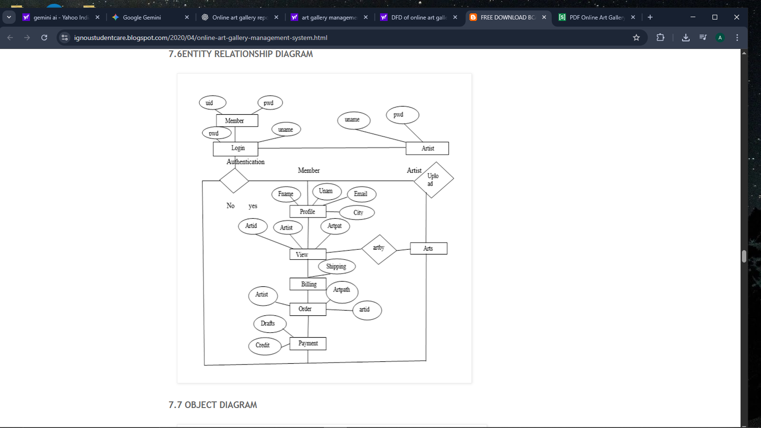
ER Diagram

Slide 8
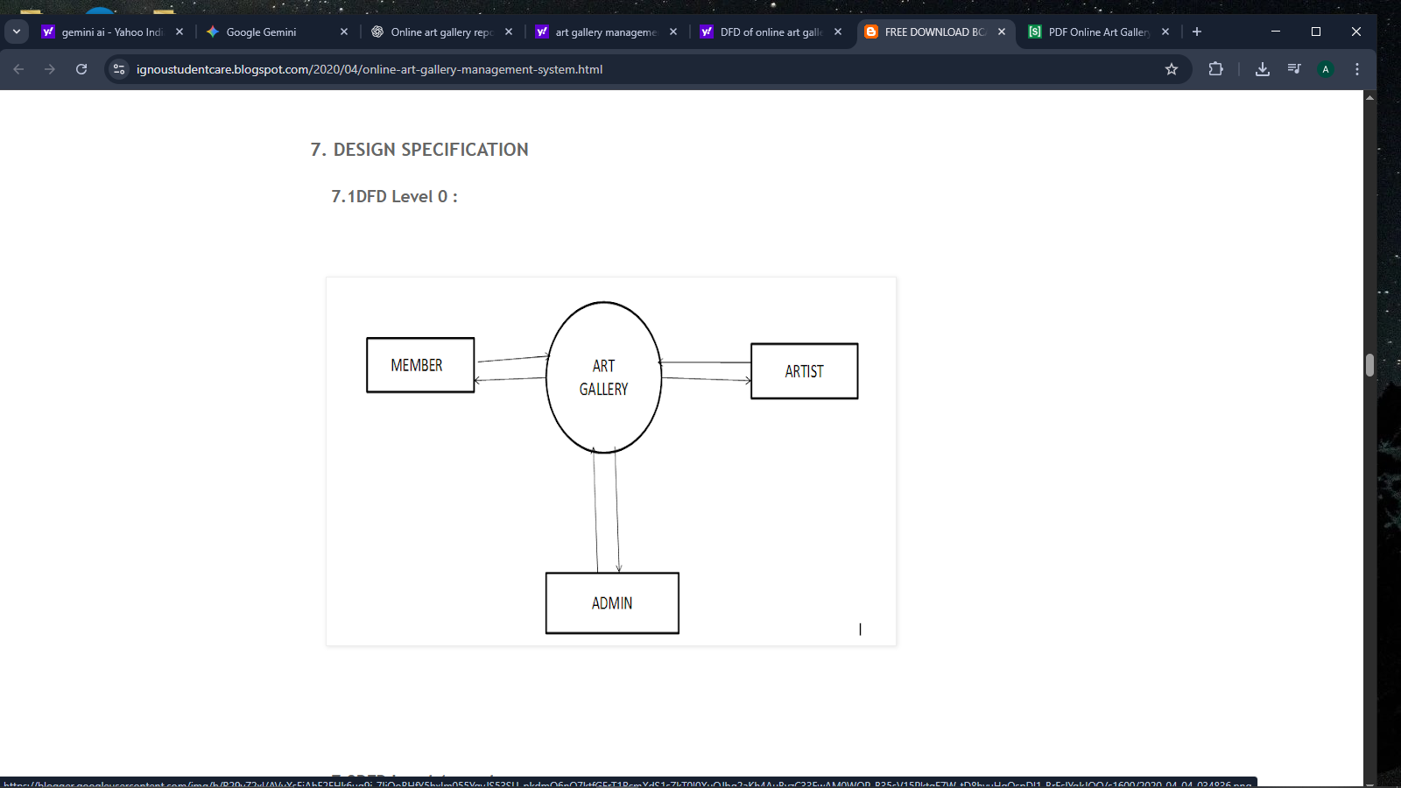
DFD

Slide 9
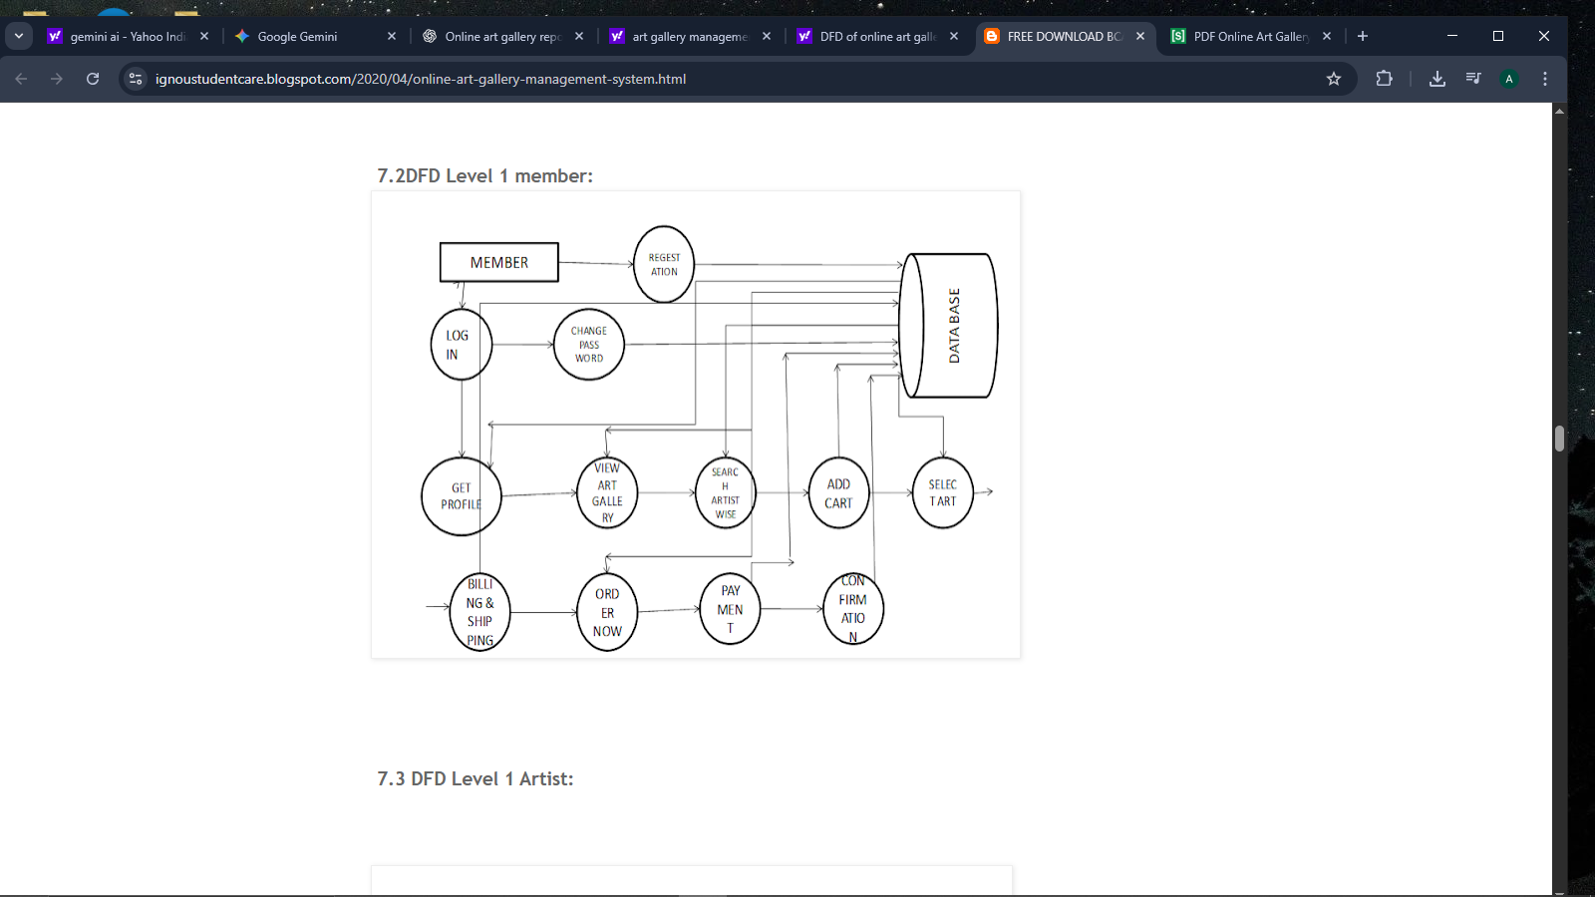

Slide 10
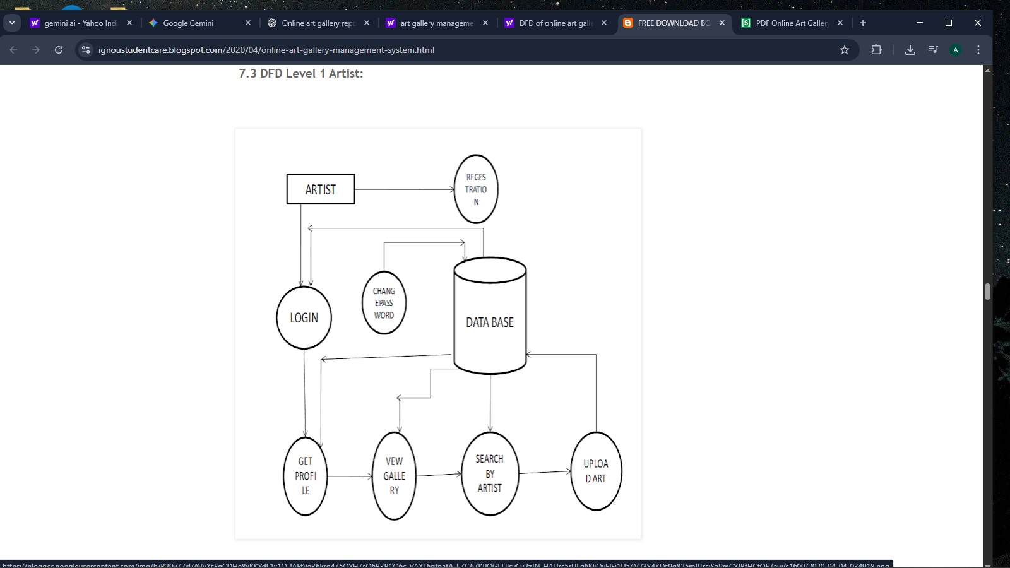

Slide 11
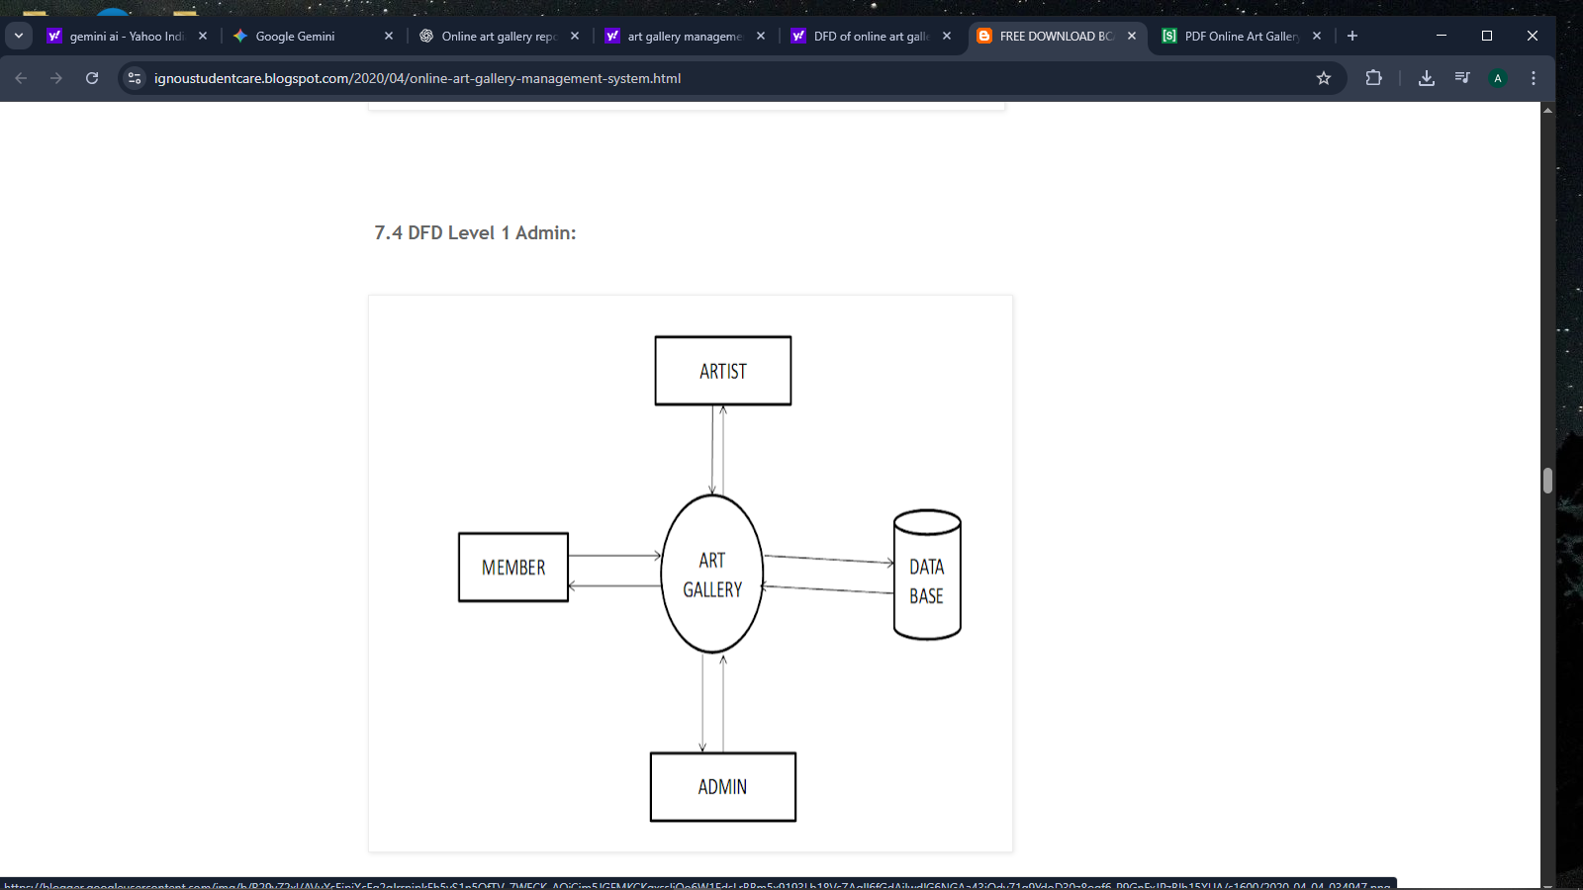

Slide 12
TABLES
Users Table
user_id (INT, Primary Key, Auto Increment)
email (VARCHAR(255), UNIQUE)
password_hash (VARCHAR(255))
username (VARCHAR(100))
user_type (ENUM('artist', 'buyer', 'admin'))
created_at (TIMESTAMP)
Artworks Table
artwork_id (INT, Primary Key, Auto Increment)
title (VARCHAR(255))
description (TEXT)
price (DECIMAL(10, 2))
image_url (VARCHAR(255))
category (VARCHAR(100))
artist_id (INT, Foreign Key, references Users)
uploaded_at (TIMESTAMP)

Slide 13
Orders Table
order_id (INT, Primary Key, Auto Increment)
buyer_id (INT, Foreign Key, references Users)
total_amount (DECIMAL(10, 2))
order_status (ENUM('pending', 'completed', 'shipped'))
order_date (TIMESTAMP)
order_Items Table
order_item_id (INT, Primary Key, Auto Increment)
order_id (INT, Foreign Key, references Orders)
artwork_id (INT, Foreign Key, references Artworks)
quantity (INT)
unit_price (DECIMAL(10, 2))
Reviews Table
review_id (INT, Primary Key, Auto Increment)
artwork_id (INT, Foreign Key, references Artworks)
user_id (INT, Foreign Key, references Users)
rating (INT)
comment (TEXT)
created_at (TIMESTAMP)

Slide 14
THANK YOU

